Slide 1

Linear Quadratic Optimal Control
Linear Systems
Xu Chen
LQ

Slide 2
Motivation
state feedback control:
▶ allows to arbitrarily assign the closed-loop eigenvalues for a controllable system
▶ the eigenvalue assignment has been manual thus far
▶ performance is implicit: we assign eigenvalues to induce proper error convergence
linear quadratic (LQ) optimal regulation control, aka, LQ regulator (or LQR):
▶ no need to specify closed-loop poles
▶ performance is explicit: a performance index is defined ahead of time
LQ

Slide 3
Problem formulation
Solution to the infinite-horizon/stationary LQ problem
Solution to the finite-horizon LQ problem
From finite-horizon LQ to stationary LQ
LQ

Slide 4

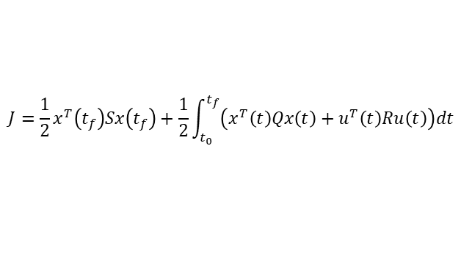
Goal
Consider an n-dimensional state-space system
$\dot{x}$(t) = Ax (t) + Bu (t) , x (t₀) = x₀ y (t) = Cx (t)
(1)
where x ∈ R^{n}, u ∈ R^{r} , and y ∈ R^{m}.
LQ optimal control aims at minimizing the performance index
$$J=\frac{1}{2}x^{T}\left(t_{f}\right)Sx\left(t_{f}\right)+\frac{1}{2}\int_{t_{0}}^{t_{f}}{\left(x^{T}\left(t\right)Qx\left(t\right)+u^{T}\left(t\right)Ru\left(t\right)\right)dt}$$
▶ S ⪰ 0, Q ⪰ 0, R ≻ 0: for a nonnegative cost and well-posed problem
▶
¹ x ^{T} (t_{f} )Sx (t_{f} ) penalizes the deviation of x from the origin at t_{f}
2
▶ x ^{T} (t)Qx (t) t ∈ (t₀, t_{f} ) penalizes the transient
▶ often, Q = C^{T} C ⇒ x ^{T} (t)Qx (t) = y (t)^{T} y (t)
▶ u^{T} (t)Ru(t) penalizes large control efforts
LQ

Slide 5
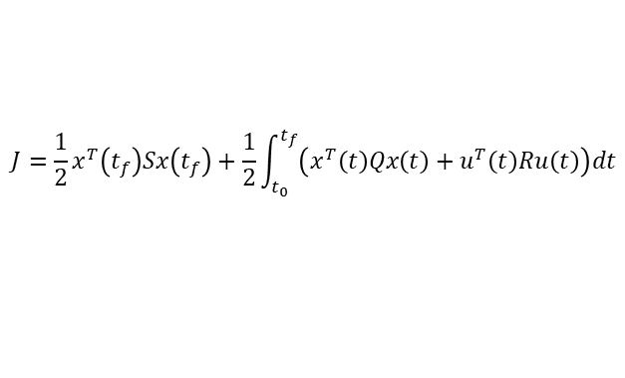
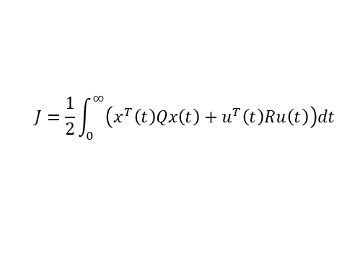
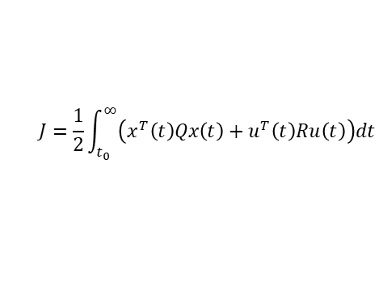
Observations
$$J=\frac{1}{2}x^{T}\left(t_{f}\right)Sx\left(t_{f}\right)+\frac{1}{2}\int_{t_{0}}^{t_{f}}{\left(x^{T}\left(t\right)Qx\left(t\right)+u^{T}\left(t\right)Ru\left(t\right)\right)dt}$$
▶ when the control horizon is made to be infinitely long, i.e.,
t_{f} → ∞, the problem reduces to the infinite-horizon LQ problem
$$J=\frac{1}{2}\int_{t_{0}}^{∞}{\left(x^{T}\left(t\right)Qx\left(t\right)+u^{T}\left(t\right)Ru\left(t\right)\right)dt}$$
▶ terminal cost is not needed, as it will turn out, that the control will have to drive x to the origin. Otherwise J will go unbounded.
▶ often, we have
$$J=\frac{1}{2}\int_{0}^{∞}{\left(x^{T}\left(t\right)Qx\left(t\right)+u^{T}\left(t\right)Ru\left(t\right)\right)dt}$$
LQ

Slide 6
Problem formulation
Solution to the infinite-horizon/stationary LQ problem
Solution to the finite-horizon LQ problem
From finite-horizon LQ to stationary LQ
LQ

Slide 7
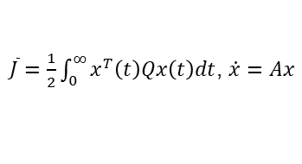
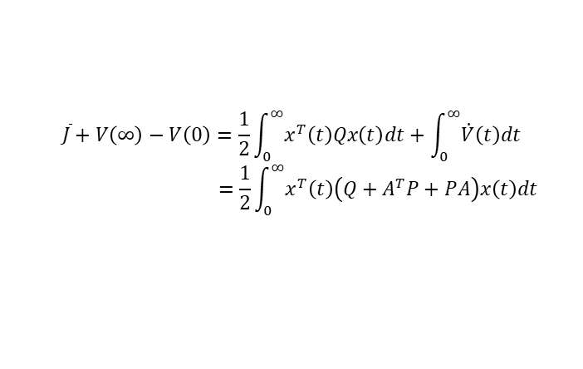
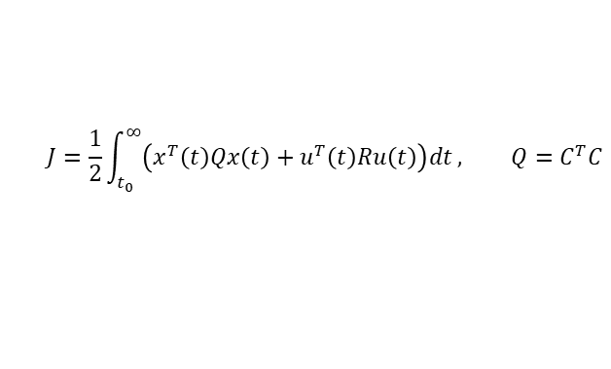
Solution concept: infinite-horizon/stationary LQ
Consider the performance index
$$J=\frac{1}{2}\int_{t_{0}}^{∞}{\left(x^{T}\left(t\right)Qx\left(t\right)+u^{T}\left(t\right)Ru\left(t\right)\right)dt}, Q=C^{T}C$$
with $\dot{x}$(t) = Ax (t) + Bu (t) , x (t₀) = x₀ and R ≻ 0.
▶
recall when addressing
$\overline{J}=\frac{1}{2}\int_{0}^{∞}{x^{T}\left(t\right)Qx\left(t\right)dt}$, $\dot{x}=Ax$
▶ we defined $V\left(t\right)=\frac{1}{2}x^{T}\left(t\right)Px(t)$, $P=P^{T}$, such that
$$\overline{J}+V\left(∞\right)−V\left(0\right)=\frac{1}{2}\int_{0}^{∞}{x^{T}\left(t\right)Qx\left(t\right)dt}+\int_{0}^{∞}{\dot{V}\left(t\right)dt}$$
$$=\frac{1}{2}\int_{0}^{∞}{x^{T}\left(t\right)\left(Q+A^{T}P+PA\right)x\left(t\right)dt}$$
▶ yielding ${\overline{J}}^{0}=\frac{1}{2}x^{T}\left(0\right)P_{+}x\left(0\right)$ where $P_{+}$ comes from
A^{T} P + PA + Q = 0, when the origin is asymptotically stable.
LQ

Slide 8
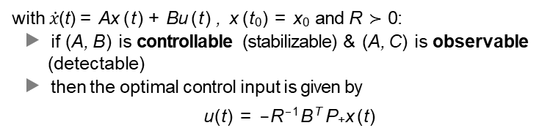
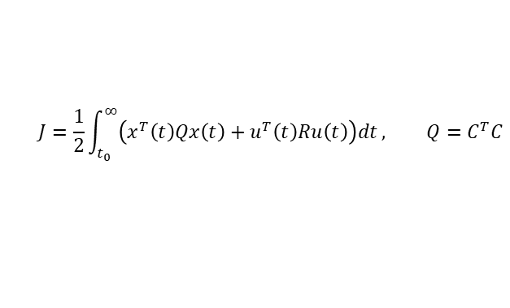
Solution of the infinite-horizon LQ
It turns out that for
$$J=\frac{1}{2}\int_{t_{0}}^{∞}{\left(x^{T}\left(t\right)Qx\left(t\right)+u^{T}\left(t\right)Ru\left(t\right)\right)dt}, Q=C^{T}C$$
with $\dot{x}$(t) = Ax (t) + Bu (t) , x (t₀) = x₀ and R ≻ 0:
▶ if (A, B) is controllable (stabilizable) & (A, C ) is observable
(detectable)
▶ then the optimal control input is given by
u(t) = −R⁻¹B^{T} P₊x (t)
▶
T
( )
where P = P is the positive (semi)definite solution of the
+
+
algebraic Riccati equation (ARE)
A^{T} P + PA − PBR⁻¹B^{T} P + Q = 0
▶ and the closed-loop system is asymptotically stable, with
J_{min} = J⁰ = ¹ x (t₀)^{T} P₊x (t₀)
2
LQ

Slide 9
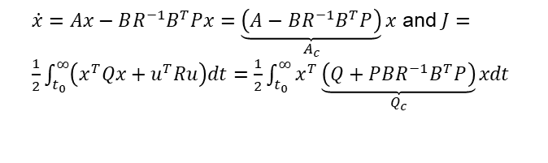
Observations
▶ the control u(t) = −R⁻¹B^{T} Px (t) is a state feedback law
▶ under the optimal control, the closed loop is given by
$\dot{x}=Ax−BR^{−1}B^{T}Px=\underset{A_{c}}{\underbrace{\left(A−BR^{−1}B^{T}P\right)}}x$ and $J=\frac{1}{2}\int_{t_{0}}^{∞}{\left(x^{T}Qx+u^{T}Ru\right)dt=\frac{1}{2}\int_{t_{0}}^{∞}{x^{T}\underset{Q_{c}}{\underbrace{\left(Q+PBR^{−1}B^{T}P\right)}}xdt}}$
▶ for the above closed-loop system, the Lyapunov Eq. is
T
A P + PA = −Q
c c c
T
−1 T −1 T −1 T
( ) (
)
⇔ A − BR B P P + P A − BR B P = −Q − PBR B P
⇔ A^{T}P + PA − PBR ⁻¹B^{T}P = −Q ⇐ the ARE!
▶ when the ARE solution P₊ is positive definite, ¹ x ^{T} P₊x is a
2
Lyapunov function for the closed-loop system
LQ

Slide 10




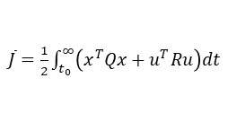
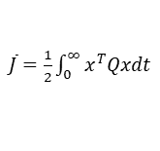
Observations
▶ Lyapunov Eq. and the ARE:
Cost
Syst. dynamics
$\overline{J}=\frac{1}{2}\int_{0}^{∞}{x^{T}Qxdt}$
$\overline{J}=\frac{1}{2}\int_{t_{0}}^{∞}{\left(x^{T}Qx+u^{T}Ru\right)dt}$
$\dot{x}$ = Ax + Bu
$\dot{x}$ = Ax
(A, B) controllable/stabilizable
(A, C ) observable/detectable
Key Eq.
Optimal control
Opt. cost
A^{T} P + PA + Q = 0
N/A
A^{T} P + PA − PBR⁻¹B^{T} P + Q = 0
u(t) = −R⁻¹B^{T} P₊ x (t)
${\overline{J}}^{0}=\frac{1}{2}x^{T}\left(0\right)P_{+}x\left(0\right)$
$J^{0}=\frac{1}{2}x^{T}\left(t_{0}\right)P_{+}x\left(t_{0}\right)$
▶ the guaranteed closed-loop stability is an attractive feature
▶ more nice properties will show up later
LQ

Slide 11
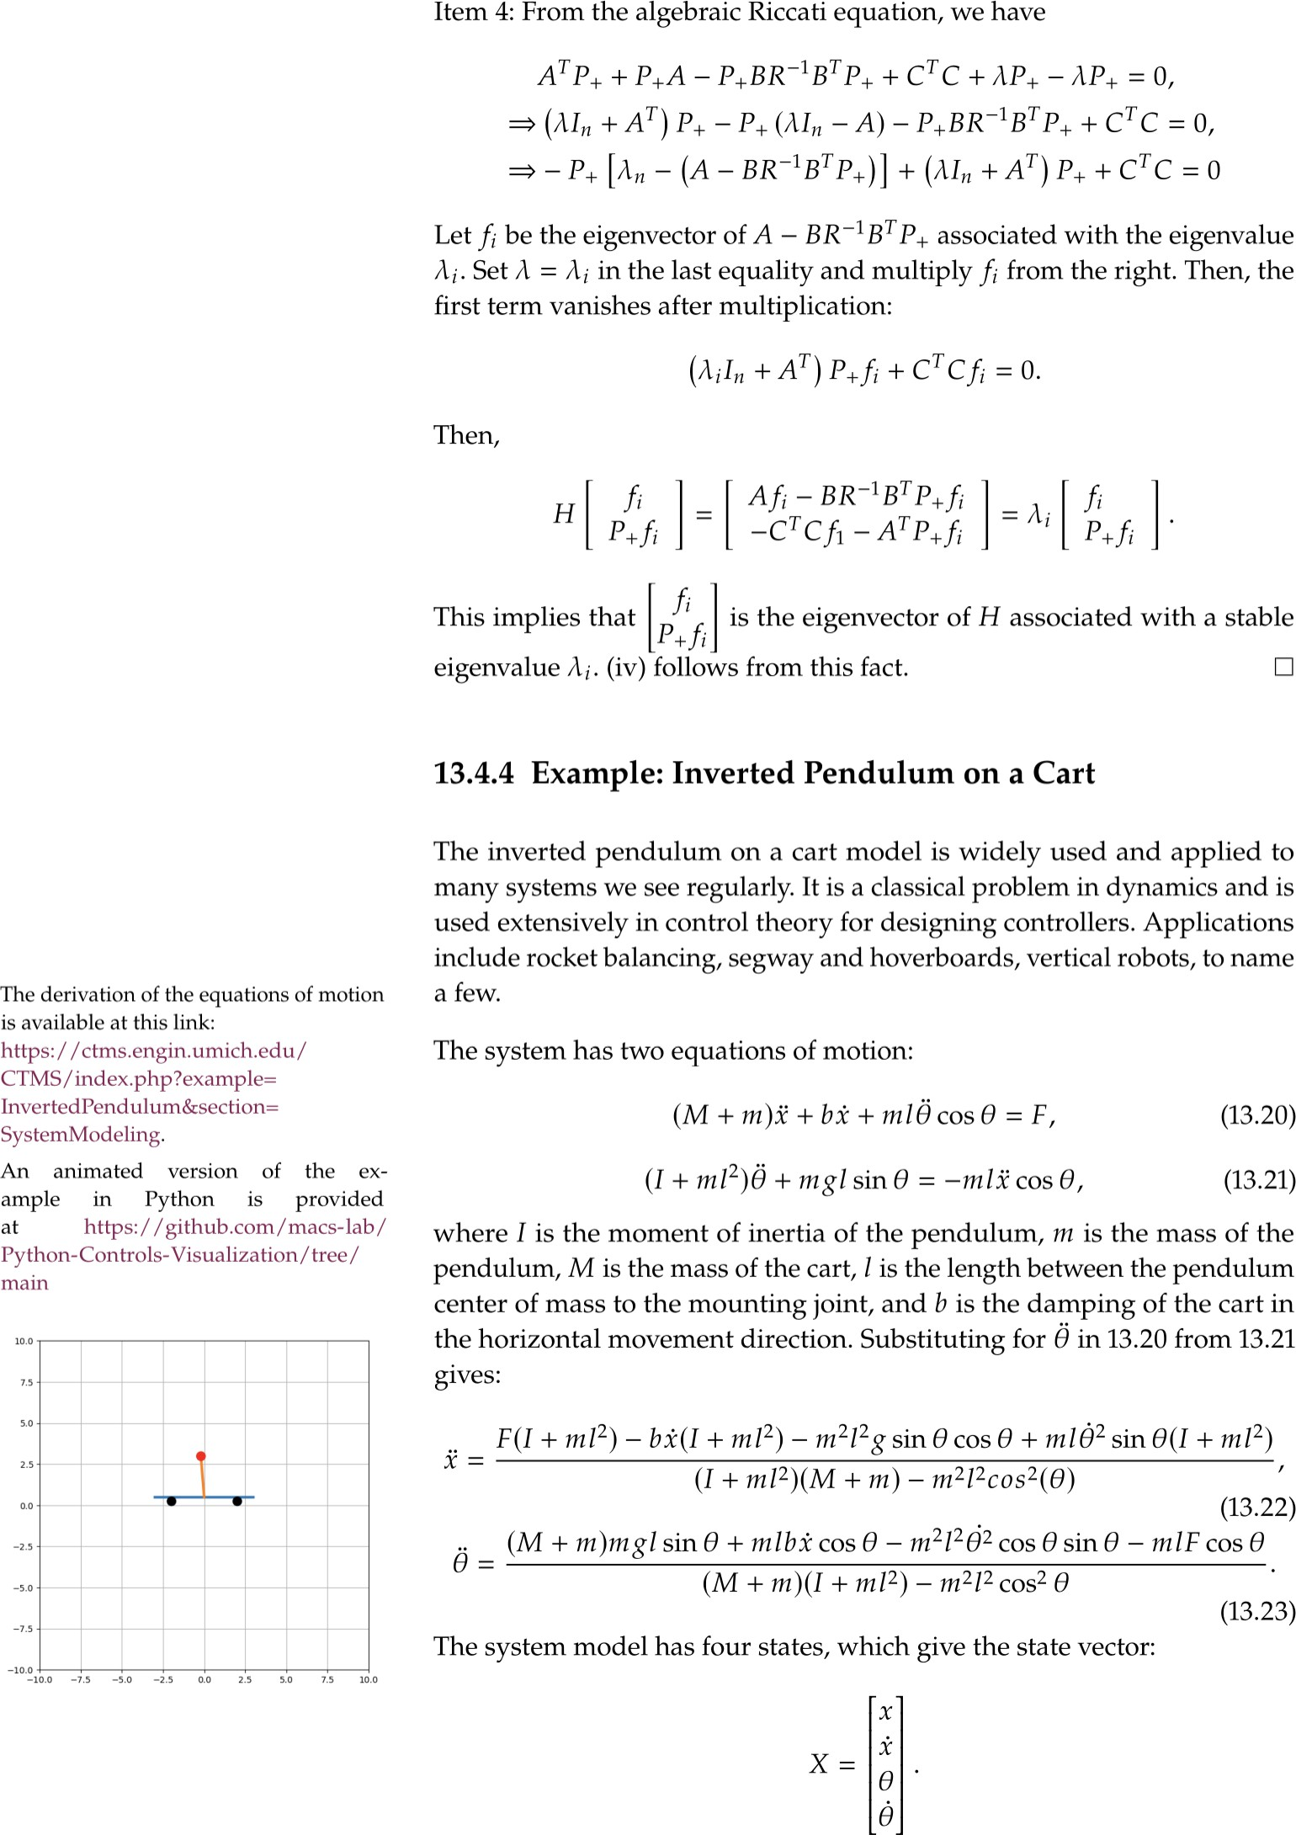

Example
LQ

Slide 12
Example
States of nonlinearized system under LQ
Derived states of linearized system under LQ
0.0
0.0
x( = u) (m)
0.2
0.2
x1
0.4
0.4
0.6
0
2
4
6
8
10
12
14
0
2
4
6
8
10
12
14
0.00
0.0
time (sec)
x (m/s)
0.25
x2
0.50
0.5
0
2
4
6
8
10
12
14
0
2
4
6
8
10
12
14
3.20
time (sec)
(rad)
3.20
x3
3.15
3.15
0.0
0
2
4
6
8
10
12
14
0
2
4
6
8
10
12
14
0.0
time (sec)
(rad/s)
0.1
0.1
x4
0.2
0.2
0
2
4
6
8
time (sec)
10
12
14
0
2
4
6
8
time (sec)
10
12
14
LQ

Slide 13
LQ with State Feedback
States (solid lines) and their estimates (dashed lines))
States (solid lines) and their estimates (dashed lines)
1.0
0.5
0.0
x1
x1
0.0
0.2
0
2
4
6
8
10
12
14
0
2
4
6
8
10
12
14
0
time (sec)
0
time (sec)
x2
5
x2
5
10
0
2
4
6
8
10
12
14
0
2
4
6
8
10
12
14
time (sec)
time (sec)
3.20
3.20
x3
3.15
x3
3.15
3.10
3.10
0
2
4
6
8
10
12
14
0
2
4
6
8
10
12
14
0
time (sec)
0
time (sec)
x4
2
x4
2
4
4
0
2
4
6
8
time (sec)
10
12
14
0
2
4
6
8
time (sec)
10
12
14
LQ

Slide 14
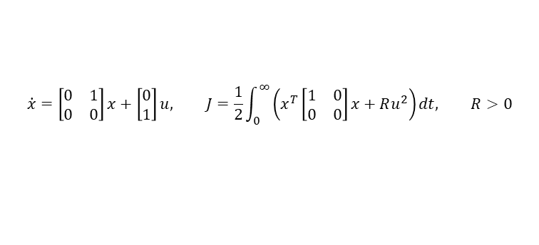


Example: Stationary LQR of a pure inertia system
▶ Consider
$$\dot{x}=\left[\begin{matrix}0 & 1 \\ 0 & 0\end{matrix}\right]x+\left[\begin{matrix}0 \\ 1\end{matrix}\right]u, J=\frac{1}{2}\int_{0}^{∞}{\left(x^{T}\left[\begin{matrix}1 & 0 \\ 0 & 0\end{matrix}\right]x+Ru^{2}\right)dt, R>0}$$
▶ the ARE is
$$0=\left[\begin{matrix}0 & 0 \\ 1 & 0\end{matrix}\right]P+P\left[\begin{matrix}0 & 1 \\ 0 & 0\end{matrix}\right]+\left[\begin{matrix}1 & 0 \\ 0 & 0\end{matrix}\right]−P\left[\begin{matrix}0 \\ 1\end{matrix}\right]\frac{1}{R}\left[\begin{matrix}0 & 1\end{matrix}\right]P⇒P_{+}=\left[\begin{matrix}\sqrt{2}R^{\frac{1}{4}} & R^{\frac{1}{2}} \\ R^{\frac{1}{2}} & \sqrt{2}R^{\frac{3}{4}}\end{matrix}\right]$$
▶ the closed-loop A matrix can be computed to be
$$A_{c}=A−BR^{−1}B^{T}P_{+}=\left[\begin{matrix}0 & 1 \\ −R^{−\frac{1}{2}} & −\sqrt{2}R^{−\frac{1}{4}}\end{matrix}\right]$$
▶ ⇒ closed-loop eigenvalues:
$$λ_{1,2}=−\frac{1}{\sqrt{2}R^{\frac{1}{4}}}±\frac{1}{\sqrt{2}R^{\frac{1}{4}}}j$$
LQ

Slide 15
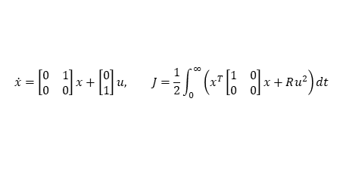

$$\dot{x}=\left[\begin{matrix}0 & 1 \\ 0 & 0\end{matrix}\right]x+\left[\begin{matrix}0 \\ 1\end{matrix}\right]u, J=\frac{1}{2}\int_{0}^{∞}{\left(x^{T}\left[\begin{matrix}1 & 0 \\ 0 & 0\end{matrix}\right]x+Ru^{2}\right)dt}$$
1.00 ^{R 0}
Root locus
0.75
0.50
0.25
Imag axis
R
0.00
0.25
0.50
0.75
1.00
1.00
0.75 0.50 0.25 0.00 0.25 0.50
Real axis
0.75 1.00
$$λ_{1,2}=−\frac{1}{\sqrt{2}R^{\frac{1}{4}}}±\frac{1}{\sqrt{2}R^{\frac{1}{4}}}j$$
Figure: Eigenvalue
evolution (root locus)
▶ R ↑ (more penalty on the control input) ⇒ λ_{1,2} move closer to the origin ⇒ slower state convergence to zero
▶ R ↓ (allow for large control efforts) ⇒ λ_{1,2} move further to the left of the complex plane ⇒ faster speed of closed-loop dynamics
LQ

Slide 16
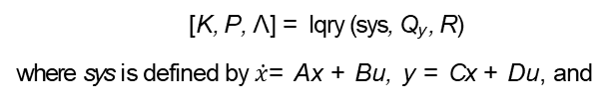
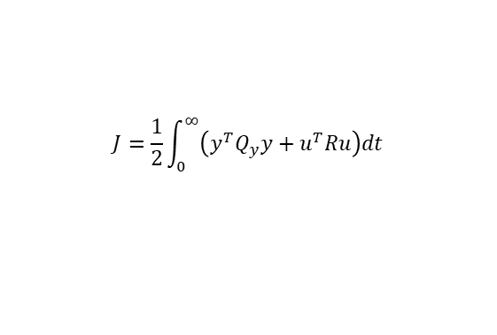
MATLAB commands
▶ care: solves the ARE for a continuous-time system:
T
( )
[P, Λ, K ] = care A, B, C C, R
where K = R⁻¹B^{T} P and Λ is a diagonal matrix with the closed-loop eigenvalues, i.e., the eigenvalues of A − BK , in the diagonal entries.
▶ lqr and lqry: provide the LQ regulator with
(
T
)
[K, P, Λ] = lqr A, B, C C, R
[K, P, Λ] = lqry (sys, Q_{y} , R)
where sys is defined by $\dot{x}$= Ax + Bu, y = Cx + Du, and
$$J=\frac{1}{2}\int_{0}^{∞}{\left(y^{T}Q_{y}y+u^{T}Ru\right)dt}$$
LQ

Slide 17
Problem formulation
Solution to the infinite-horizon/stationary LQ problem
Solution to the finite-horizon LQ problem
From finite-horizon LQ to stationary LQ
LQ

Slide 18
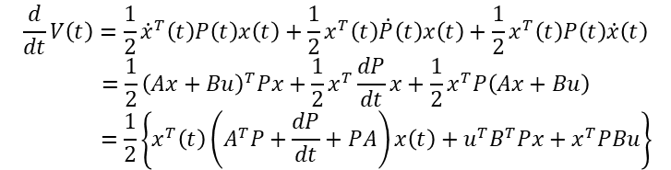
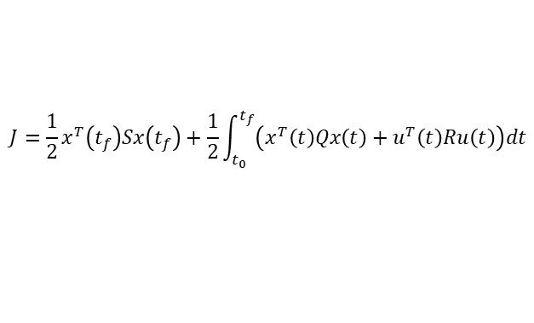
Solution to the finite-horizon LQ
Consider the performance index
$$J=\frac{1}{2}x^{T}\left(t_{f}\right)Sx\left(t_{f}\right)+\frac{1}{2}\int_{t_{0}}^{t_{f}}{\left(x^{T}\left(t\right)Qx\left(t\right)+u^{T}\left(t\right)Ru\left(t\right)\right)dt}$$
with $\dot{x}$ = Ax + Bu, x (t₀) = x₀, S ⪰ 0, R ≻ 0, and Q = C^{T} C .
▶ do a similar Lyapunov construction: V (t) ≜ ¹ x ^{T} (t) P (t) x (t)
2
▶ then
$$\frac{d}{dt}V\left(t\right)=\frac{1}{2}{\dot{x}}^{T}\left(t\right)P\left(t\right)x\left(t\right)+\frac{1}{2}x^{T}\left(t\right)\dot{P}\left(t\right)x\left(t\right)+\frac{1}{2}x^{T}\left(t\right)P\left(t\right)\dot{x}\left(t\right)$$
$$=\frac{1}{2}{\left(Ax+Bu\right)}^{T}Px+\frac{1}{2}x^{T}\frac{dP}{dt}x+\frac{1}{2}x^{T}P\left(Ax+Bu\right)$$
$$=\frac{1}{2}\left\{x^{T}\left(t\right)\left(A^{T}P+\frac{dP}{dt}+PA\right)x\left(t\right)+u^{T}B^{T}Px+x^{T}PBu\right\}$$
LQ

Slide 19
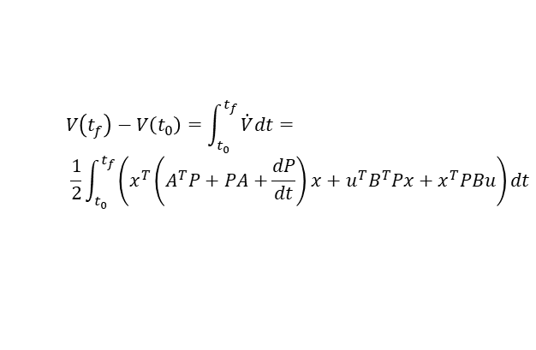
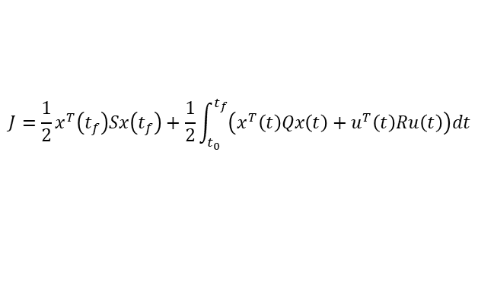
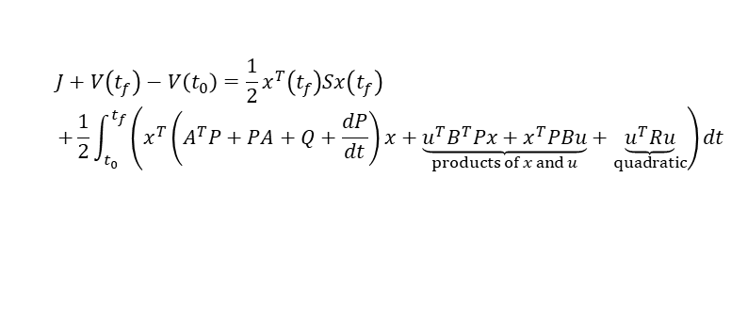
Solution to the finite-horizon LQ
with ^{d} V (t) from the last slide, we have
dt
$$V\left(t_{f}\right)−V\left(t_{0}\right)=\int_{t_{0}}^{t_{f}}{\dot{V}dt=}$$
$$\frac{1}{2}\int_{t_{0}}^{t_{f}}{\left(x^{T}\left(A^{T}P+PA+\frac{dP}{dt}\right)x+u^{T}B^{T}Px+x^{T}PBu\right)dt}$$
▶ adding
$$J=\frac{1}{2}x^{T}\left(t_{f}\right)Sx\left(t_{f}\right)+\frac{1}{2}\int_{t_{0}}^{t_{f}}{\left(x^{T}\left(t\right)Qx\left(t\right)+u^{T}\left(t\right)Ru\left(t\right)\right)dt}$$
to both sides yields
$$J+V\left(t_{f}\right)−V\left(t_{0}\right)=\frac{1}{2}x^{T}\left(t_{f}\right)Sx\left(t_{f}\right)$$
$$+\frac{1}{2}\int_{t_{0}}^{t_{f}}{\left(x^{T}\left(A^{T}P+PA+Q+\frac{dP}{dt}\right)x+\underset{products of x and u}{\underbrace{u^{T}B^{T}Px+x^{T}PBu}}+\underset{quadratic}{\underbrace{u^{T}Ru}}\right)dt}$$
LQ

Slide 20

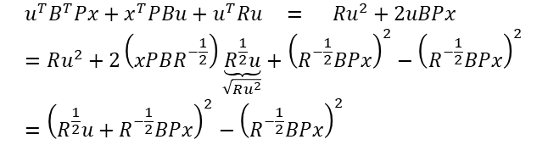
Solution to the finite-horizon LQ
▶ “complete the squares” in $\underset{products of x and u}{\underbrace{u^{T}B^{T}Px+x^{T}PBu}}+\underset{quadratic}{\underbrace{u^{T}Ru}}$:
scaler case
$$u^{T}B^{T}Px+x^{T}PBu+u^{T}Ru = Ru^{2}+2uBPx=Ru^{2}+2\left(xPBR^{−\frac{1}{2}}\right)\underset{\sqrt{Ru^{2}}}{\underbrace{R^{\frac{1}{2}}u}}+{\left(R^{−\frac{1}{2}}BPx\right)}^{2}−{\left(R^{−\frac{1}{2}}BPx\right)}^{2}={\left(R^{\frac{1}{2}}u+R^{−\frac{1}{2}}BPx\right)}^{2}−{\left(R^{−\frac{1}{2}}BPx\right)}^{2}$$
▶ extending the concept to the general vector case:
$$u^{T}B^{T}Px+x^{T}PBu+u^{T}Ru={\left\|R^{\frac{1}{2}}u+R^{−\frac{1}{2}}B^{T}Px\right\|}_{2}^{2}−x^{T}PBR^{−1}B^{T}Px$$
LQ

Slide 21

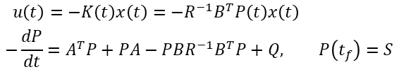
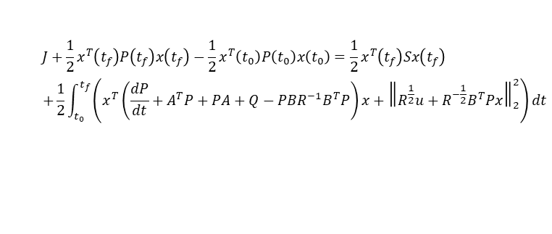
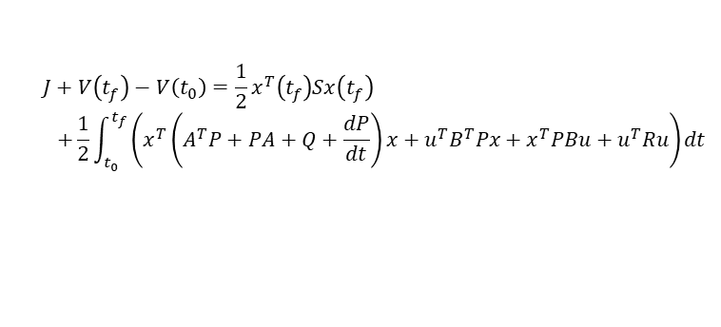
Solution to the finite-horizon LQ
$$J+V\left(t_{f}\right)−V\left(t_{0}\right)=\frac{1}{2}x^{T}\left(t_{f}\right)Sx\left(t_{f}\right)$$
$$+\frac{1}{2}\int_{t_{0}}^{t_{f}}{\left(x^{T}\left(A^{T}P+PA+Q+\frac{dP}{dt}\right)x+u^{T}B^{T}Px+x^{T}PBu+u^{T}Ru\right)dt}$$
⇓“completing the squares”
$$J+\frac{1}{2}x^{T}\left(t_{f}\right)P\left(t_{f}\right)x\left(t_{f}\right)−\frac{1}{2}x^{T}\left(t_{0}\right)P\left(t_{0}\right)x\left(t_{0}\right)=\frac{1}{2}x^{T}\left(t_{f}\right)Sx\left(t_{f}\right)$$
$$+\frac{1}{2}\int_{t_{0}}^{t_{f}}{\left(x^{T}\left(\frac{dP}{dt}+A^{T}P+PA+Q−PBR^{−1}B^{T}P\right)x+{\left\|R^{\frac{1}{2}}u+R^{−\frac{1}{2}}B^{T}Px\right\|}_{2}^{2}\right)dt}$$
▶ the best that the control can do in minimizing the cost is to have
$$u\left(t\right)=−K\left(t\right)x\left(t\right)=−R^{−1}B^{T}P\left(t\right)x\left(t\right)$$
$$−\frac{dP}{dt}=A^{T}P+PA−PBR^{−1}B^{T}P+Q, P\left(t_{f}\right)=S$$
to yield the optimal cost $J^{0}=\frac{1}{2}x_{0}^{T}P\left(t_{0}\right)x_{0}$
LQ

Slide 22



Observations
$$u\left(t\right)=−K\left(t\right)x\left(t\right)=−R^{−1}B^{T}P\left(t\right)x\left(t\right)$$
$$−\frac{dP}{dt}=A^{T}P+PA−PBR^{−1}B^{T}P+Q, P\left(t_{f}\right)=S$$
optimal state feedback control
the Riccati differential equation
▶ boundary condition of the Riccati equation is given at the final time t_{f} ⇒ the equation must be integrated backward in time
▶ backward integration of
$$−\frac{dP}{dt}$$
T −1 T
= A P + PA + Q − PBR B P, P (t ) = S
f
is equivalent to the forward integration of
$$\frac{dP^{∗}}{dt}$$
= A^{T} P∗ + P∗A + Q − P∗BR⁻¹B^{T} P∗, P∗ (0) = S (2)
by letting P (t) = P∗ (t_{f} − t)
▶ Eq. (2) can be solved by numerical integration
LQ

Slide 23
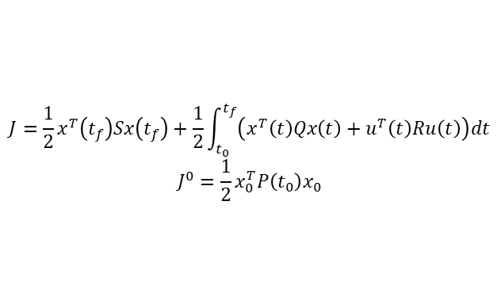
Observations
$$J=\frac{1}{2}x^{T}\left(t_{f}\right)Sx\left(t_{f}\right)+\frac{1}{2}\int_{t_{0}}^{t_{f}}{\left(x^{T}\left(t\right)Qx\left(t\right)+u^{T}\left(t\right)Ru\left(t\right)\right)dt}$$
$$J^{0}=\frac{1}{2}x_{0}^{T}P\left(t_{0}\right)x_{0}$$
▶ the minimum value J⁰ is a function of the initial state x (t₀)
▶ J (and hence J⁰) is nonnegative ⇒ P (t₀) is at least positive semidefinite
▶ t₀ can be taken anywhere in (0, t_{f} ) ⇒ P (t) is at least positive
semidefinite for any t
▶ the state feedback law is time varying because of P (t)
LQ

Slide 24
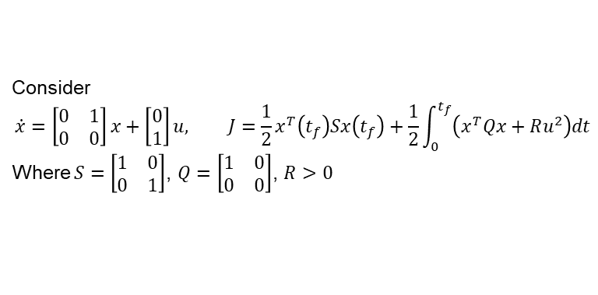
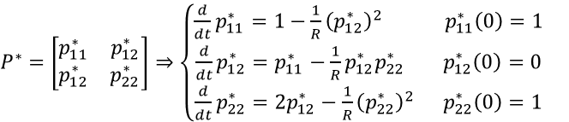
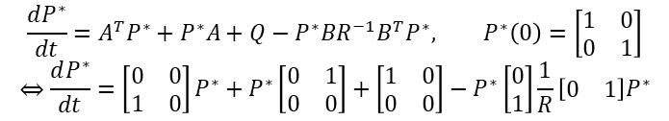
Example: LQR of a pure inertia system
Consider
$$\dot{x}=\left[\begin{matrix}0 & 1 \\ 0 & 0\end{matrix}\right]x+\left[\begin{matrix}0 \\ 1\end{matrix}\right]u, J=\frac{1}{2}x^{T}\left(t_{f}\right)Sx\left(t_{f}\right)+\frac{1}{2}\int_{0}^{t_{f}}{\left(x^{T}Qx+Ru^{2}\right)dt}$$
Where $S=$ $\left[\begin{matrix}1 & 0 \\ 0 & 1\end{matrix}\right]$, $Q=\left[\begin{matrix}1 & 0 \\ 0 & 0\end{matrix}\right]$, $R>0$
▶ we let P (t) = P∗ (t_{f} − t) and solve
$$\frac{dP^{∗}}{dt}=A^{T}P^{∗}+P^{∗}A+Q−P^{∗}BR^{−1}B^{T}P^{∗}, P^{∗}\left(0\right)=\left[\begin{matrix}1 & 0 \\ 0 & 1\end{matrix}\right]$$
$$⇔\frac{dP^{∗}}{dt}=\left[\begin{matrix}0 & 0 \\ 1 & 0\end{matrix}\right]P^{∗}+P^{∗}\left[\begin{matrix}0 & 1 \\ 0 & 0\end{matrix}\right]+\left[\begin{matrix}1 & 0 \\ 0 & 0\end{matrix}\right]−P^{∗}\left[\begin{matrix}0 \\ 1\end{matrix}\right]\frac{1}{R}\left[\begin{matrix}0 & 1\end{matrix}\right]P^{∗}$$
▶ letting
$P^{∗}=\left[\begin{matrix}p_{11}^{∗} & p_{12}^{∗} \\ p_{12}^{∗} & p_{22}^{∗}\end{matrix}\right]⇒\left\{\begin{aligned}\frac{d}{dt}p_{11}^{∗}=1−\frac{1}{R}{\left(p_{12}^{∗}\right)}^{2} p_{11}^{∗}\left(0\right)=1 \\ \frac{d}{dt}p_{12}^{∗}=p_{11}^{∗}−\frac{1}{R}p_{12}^{∗}p_{22}^{∗} p_{12}^{∗}\left(0\right)=0 \\ \frac{d}{dt}p_{22}^{∗}=2p_{12}^{∗}−\frac{1}{R}{\left(p_{22}^{∗}\right)}^{2} p_{22}^{∗}\left(0\right)=1\end{aligned}\right.$
LQ

Slide 25
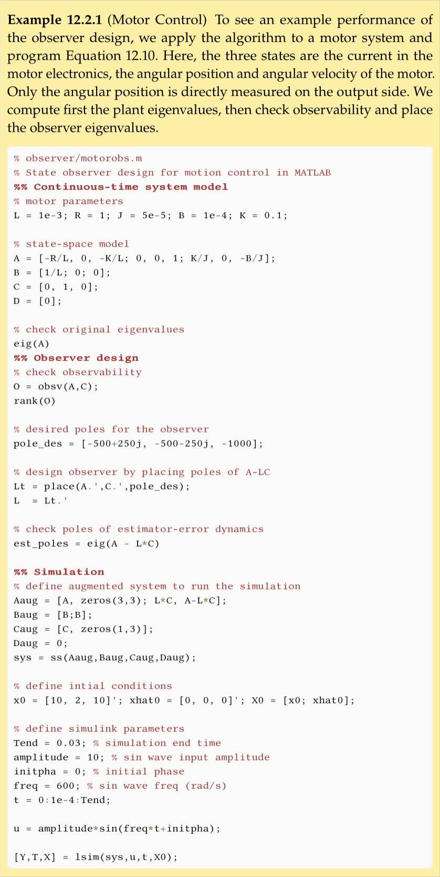
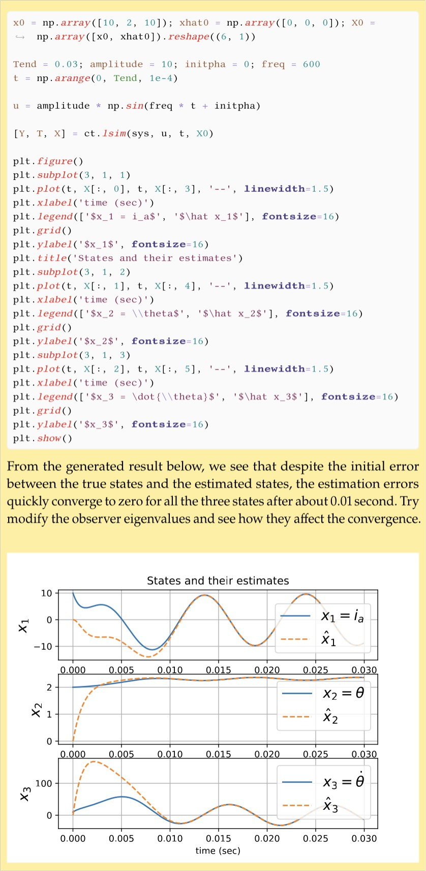

Example: LQR of a pure inertia system
LQ

Slide 26

Example: LQR of a pure inertia system: analysis
P * with R = 0.0001
1.0
_{p} *
11
_{p} *
12
_{p} *
0.8
22
0.6
0.4
0.2
0.0
0.0
0.2 0.4 0.6 0.8 1.0
time/s
1.2 1.4
$$\left[\begin{matrix}1 & 0 \\ 0 & 1\end{matrix}\right]$$
∗
∗
Figure: LQ example: P (0) =
, P (t) = P (t − t)
f
▶ if the final time t_{f} is large, P∗ (t) forward converges to a stationary value
▶ i.e., P (t) backward converges to a stationary value at P (0)
LQ

Slide 27

Example: LQR of a pure inertia system: analysis
1.75
P * with R = 1
P * with R = 100
1.50
40
1.25
30
1.00
_{p} *
11
_{p} *
0.75
20
12
_{p} *
22
0.50
_{p} *
10
0.25
11
_{p} *
12
0.00
_{p} *
0
22
0
2
4
6 8 10
time/s
12
14
0
5
10 15 20 25
time/s
30 35 40
$$\left[\begin{matrix}1 & 0 \\ 0 & 1\end{matrix}\right]$$
∗
Figure: LQ example with different penalties on control. P (0) =
▶ a larger R results in a longer transient
▶ i.e., a larger penalty on the control input yields a longer time to settle
LQ
27 / 34

Slide 28


Example: LQR of a pure inertia system: analysis
P * with R = 100
P * with R = 100 and a different initial value
_{p} *
11
40
60
_{p} *
12
_{p} *
22
50
30
_{p} *
40
11
_{p} *
20
12
30
_{p} *
22
20
10
10
0
0
0
5 10 15 20 25
time/s
30
35
40
0
5
10
15 20 25 30
time/s
35
40
$$\left[\begin{matrix}1 & 0 \\ 0 & 1\end{matrix}\right]$$
$$\left[\begin{matrix}20 & 0 \\ 0 & 2\end{matrix}\right]$$
∗
∗
(a) P (0) =
(b) P (0) =
Figure: LQ with different boundary values in Riccati difference Eq.
▶ for the same R, the initial value P (t_{f} ) = S becomes irrelevant
as t_{f} → ∞
LQ

Slide 29
Problem formulation
Solution to the infinite-horizon/stationary LQ problem
Solution to the finite-horizon LQ problem
From finite-horizon LQ to stationary LQ
LQ

Slide 30


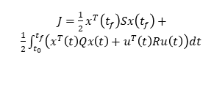


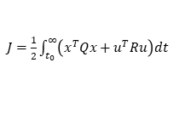

From LQ to stationary LQ
▶ the ARE and the Riccati differential Eq.:
$J=\frac{1}{2}x^{T}\left(t_{f}\right)Sx\left(t_{f}\right)+$
$\frac{1}{2}\int_{t_{0}}^{t_{f}}{\left(x^{T}\left(t\right)Qx\left(t\right)+u^{T}\left(t\right)Ru\left(t\right)\right)dt}$
Cost
$J=\frac{1}{2}\int_{t_{0}}^{∞}{\left(x^{T}Qx+u^{T}Ru\right)dt}$
$\dot{x}$= Ax + Bu
Syst.
(A, B) controllable/stabilizable
(A, C ) observable/detectable
$\dot{x}$= Ax + Bu
Key Eq.
Opt. control Opt. cost
$−\frac{dP}{dt}=A^{T}P+PA−PBR^{−1}B^{T}P+Q$
A^{T} P + PA − PBR⁻¹B^{T} P + Q = 0
P(t ) = S
u(t) = −R⁻¹B^{T} P₊ x (t)
f
$$u\left(t\right)=−R^{−1}B^{T}P\left(t\right)x\left(t\right)$$
$J^{0}=\frac{1}{2}x_{0}^{T}P_{+}x_{0}$
$J^{0}=\frac{1}{2}x_{0}^{T}P\left(t_{0}\right)x_{0}$
▶ in the example, we see that P in the Riccati differential Eq. converges to a stationary value given sufficient time
▶ when t_{f} → ∞, the Riccati differential Eq. converges to ARE and the LQ becomes the stationary LQ, under two conditions that we now discuss in details:
▶ (A, B) is controllable/stabilizable
▶ (A, C ) is observable/detectable
LQ

Slide 31
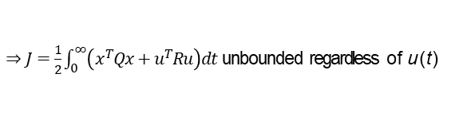
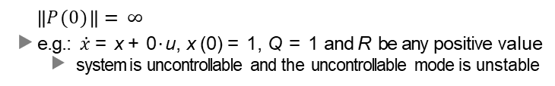

Need for controllability/stabilizability
if (A, B) is controllable or stabilizable, then P (t) is guaranteed to converge to a bounded and stationary value
▶ for uncontrollable or unstabilizable systems, there can be unstable uncontrollable modes that cause J to be unbounded
▶
0 1 T
then if J = x P (0) x is unbounded, we will have
2 0
0
$$\left\|P(0)\right\|=∞$$
▶ e.g.: $\dot{x}$ = x + 0 · u, x (0) = 1, Q = 1 and R be any positive value
▶ system is uncontrollable and the uncontrollable mode is unstable
▶ x (t) will keep increasing to infinity
▶
$⇒J=\frac{1}{2}\int_{0}^{∞}{\left(x^{T}Qx+u^{T}Ru\right)dt}$unbounded regardless of u (t)
▶ in this case, the Riccati equation is
$$−\frac{dP}{dt}=P+P+1=2P+1⇔\frac{dP^{∗}}{dt}=2P^{∗}+1$$
forward integration of P∗ (backward integration of P), will drive
P∗ (∞) and P (0) to infinity
LQ

Slide 32
Need for observability/detectability
if (A, C ) is observable or detectable, the optimal state feedback control system will be asymptotically stable
▶ intuition: if the system is observable, y = Cx will relate to all states ⇒ regulating x^{T} Qx = x ^{T} C^{T} Cx will regulate all states
▶ formally: if (A, C ) is observable (detectable), the solution of the Riccati equation will converge to a positive (semi)definite value P₊ (proof in course notes)
LQ

Slide 33
Additional excellent properties of stationary LQ
▶ we know stationary LQR yields guaranteed closed-loop stability for controllable (stabilizable) and observable (detectable) systems
It turns out that LQ regulators with full state feedback has excellent additional properties of:
▶ at least a 60 degree phase margin
▶ infinite gain margin
▶ stability is guaranteed up to a 50% reduction in the gain
LQ

Slide 34
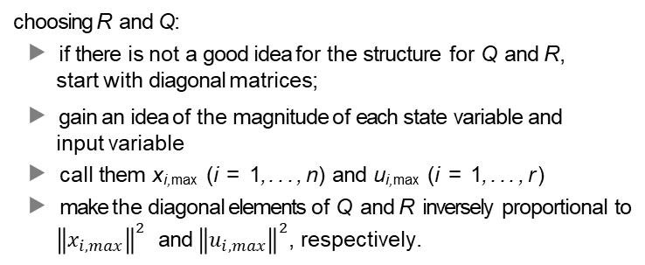
Applications and practice
choosing R and Q:
▶ if there is not a good idea for the structure for Q and R, start with diagonal matrices;
▶ gain an idea of the magnitude of each state variable and input variable
▶ call them x_{i,max} (i = 1, . . . , n) and u_{i,max} (i = 1, . . . , r )
▶ make the diagonal elements of Q and R inversely proportional to
${\left\|x_{i,max}\right\|}^{2}$ and ${\left\|u_{i,max}\right\|}^{2}$,respectively.
LQ

